Slide 1
KNN Demo
Accelerate Data Academy
Kurt Schuepfer

Slide 2
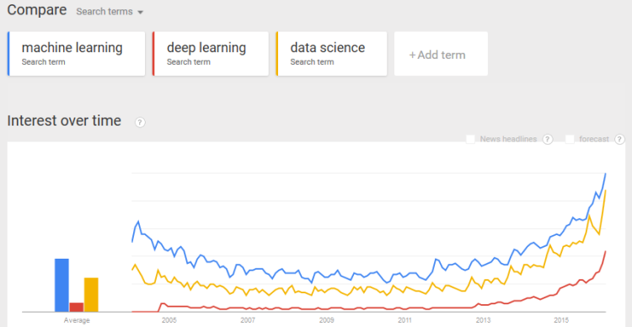
Data Science is Rising
Source: https://www.datasciencecentral.com/profiles/blogs/data-science-ml-deep-learning-iot-ai-exploding

Slide 3
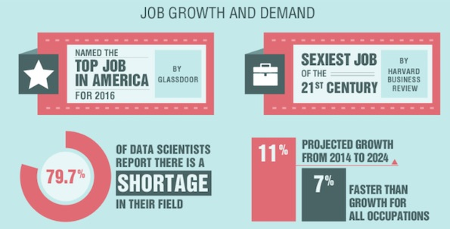
Data Science is Rising
Source: https://www.kdnuggets.com/2016/04/advantages-career-data-science.html

Slide 4
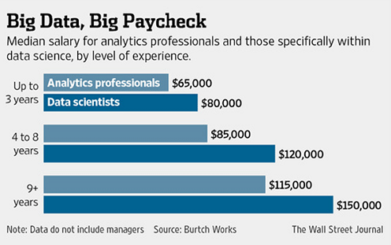
Data Science is in Demand
Source: https://alldatascience.com/2018/01/02/what-is-data-science/

Slide 5
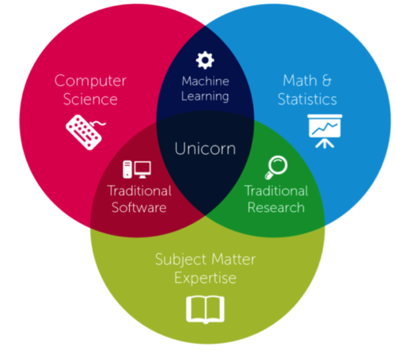
What is a Data Scientist?
Source: https://hub.appirio.com/cloud-powered-blog/why-data-science-is-so-hot-right-now
Notes:
https://hub.appirio.com/cloud-powered-blog/why-data-science-is-so-hot-right-now

Slide 6


Slide 7
Today
We will get started today learning one algorithm
Add one more skill to your toolkit
KNN algorithm

Slide 8
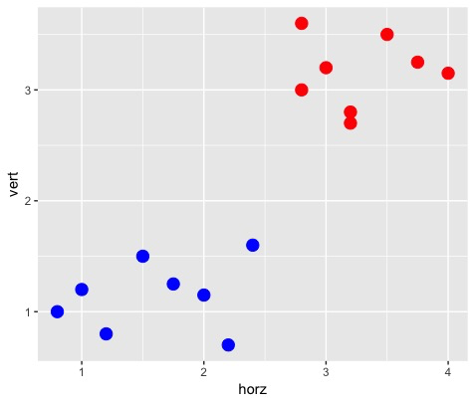
Intuition for KNN
Set of points (x, y)
Two classes
Which class does the box
belong to?
Nearby points (neighbors)
are red.
- Therefore, predict red.
?
Notes:
Suppose you have this data set. 2 dimensional.
Blue and red are training samples.
We also have a testing point
After asking class which red or blue. Ask them how they did it? Decision tree cutpoints? Did you compute a Naïve Bayes prior?

Slide 9
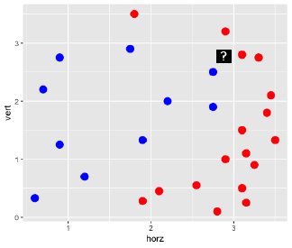
KNN Algorithm
For each test sample:
1) Find the nearest neighbor
Use a distance function
Euclidean, Hamming, Minkowski
2) Identify the class of the nearest neighbor
3) Use that to predict the test sample class

Slide 10
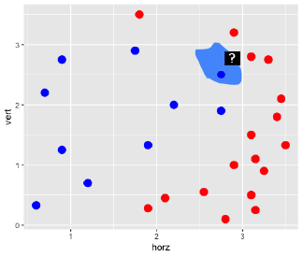
Voronoi Cells
Not just the point
Whole region around the point that is going to be blue
Voronoi cell
Every training example has a Voronoi cell

Slide 11
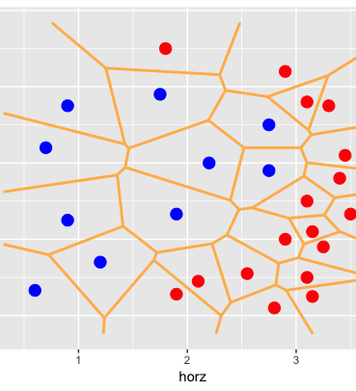
Voronoi Tesselation
Divide entire space into regions where each region pertains to one training example

Slide 12
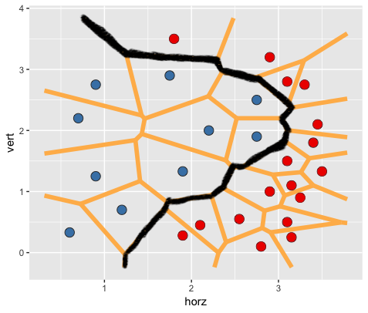
Decision Boundary
Boundary traces the Voronoi cells
Separates classes
Very flexible
decision boundary
Non-linear
Can be any shape

Slide 13
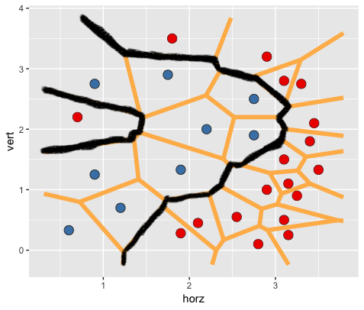
Decision Boundary
However, this flexibility means it can be prone to overfitting the data
Sensitive to outliers
Is there a solution?
?
Notes:
Outliers can dramatically change decision boundary.
Doesn’t have any notion of prior. Doesn’t compute any confidence in the class.

Slide 14
K in K-Nearest Neighbors
Solution: choose a larger value for K
Look at 3 or 5 nearest neighbors
Take a ‘majority vote’ for class membership
?
Notes:
Outliers can dramatically change decision boundary.
Doesn’t have any notion of prior. Doesn’t compute any confidence in the class.

Slide 15
K in K-Nearest Neighbors
Increasing K makes the algorithm more stable
However, just like you can ‘overfit’ with a small K, you can also ‘underfit’ with too big a K.
How to find optimal K?
?
Notes:
Outliers can dramatically change decision boundary.
Doesn’t have any notion of prior. Doesn’t compute any confidence in the class.

Slide 16
Cross Validation
Simple cross validation (holdout set)
Split data into 80% train and 20% validation
Determine K’s to test (e.g. 1, 3, 5, 7, 9)
For each K:
Build KNN algorithm on the training data set
Predict outcomes of your validation data set
Compare predicted to actual outcomes
What % were classified correctly?
Store accuracy rate in a data frame
Choose K that maximizes classification accuracy
Notes:
Outliers can dramatically change decision boundary.
Doesn’t have any notion of prior. Doesn’t compute any confidence in the class.

Slide 17
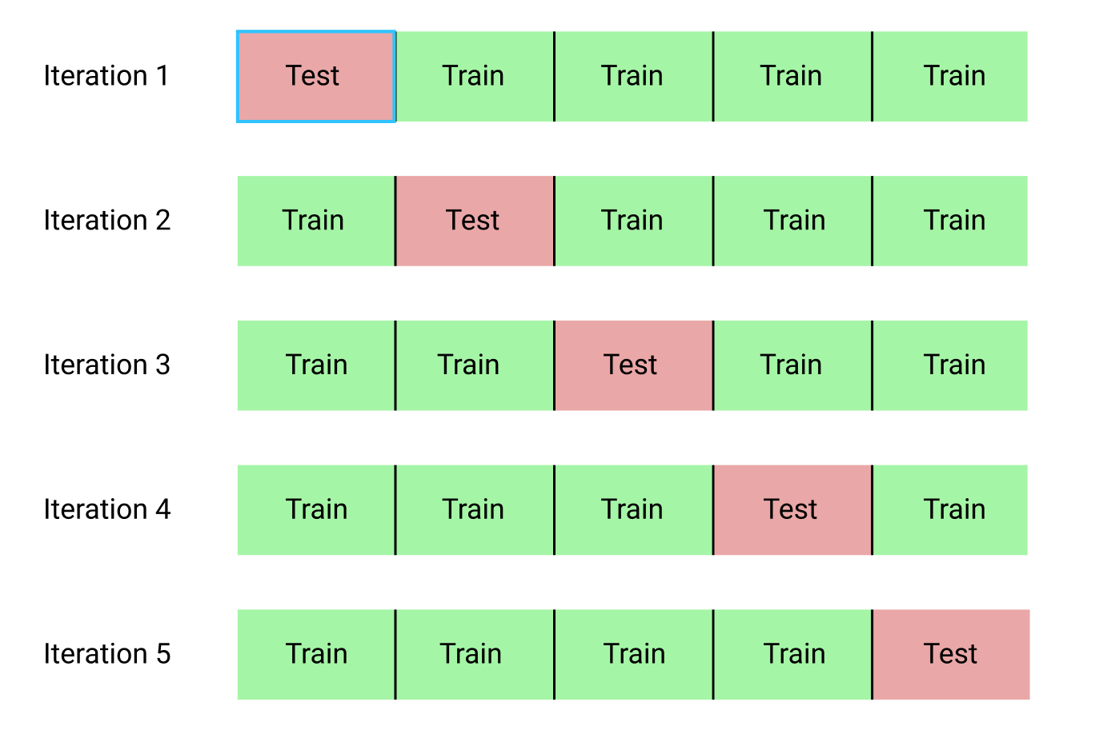
5-Fold Cross Validation
Divide the data into 5 equal parts (folds)
For each K:
For each fold:
Perform simple cross validation
80% (4 folds) as the training set
20% (1 fold) as the holdout/validation set
Compute and store mean
classification accuracy across
all 5 folds
Choose K that maximizes
classification accuracy

Slide 18
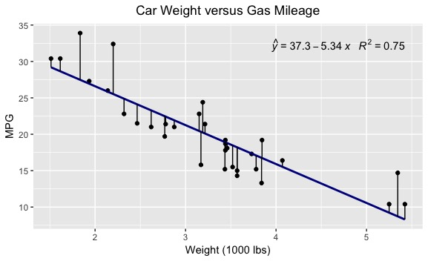
KNN Regression
Now that we have learned the basics, we can extend this algorithm easily into the world of regression

Slide 19
KNN Regression
Regression
Predicting a continuous, numeric outcome
E.g. home prices, height, etc.

Slide 20
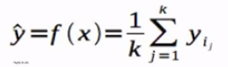
KNN Regression
For KNN-regression, algorithm is (mostly) identical to KNN-classification
Classification: predicts class membership based on a ‘majority vote’ of KNN
Regression: predicts Y value based on the mean Y value of the K-nearest neighbors

Slide 21
KNN Regression
For each testing sample
Compute the distance to all training samples
Find K closest points
Prediction: the mean of those points
Optimize K with cross validation
Select K that minimizes MSE
MSE = mean squared difference between predicted and actual value

Slide 22
Practical Tips
KNN works well with smaller data sets
KNN works best with numeric features
Need to scale all features prior to running algorithm
KNN requires full data set (no NA’s)
Can also tune across distance metrics

Slide 23
Demo
Now we are ready to learn how to do KNN in R

Slide 24
Summary
Today we learned what KNN is
How KNN works
How we can use it for classification
How we can use it for regression
How to tune it with cross validation
Practical tips for implementing it
How to code it in R

Slide 25

Upcoming Data Science Events
Unsupervised Machine Learning Workshop
November 11
Linear Regression Deep Dive Workshop
November 17
acceleratecincy.com

